Slide 1
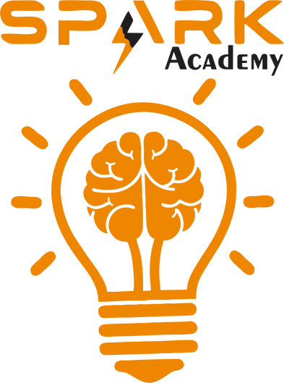
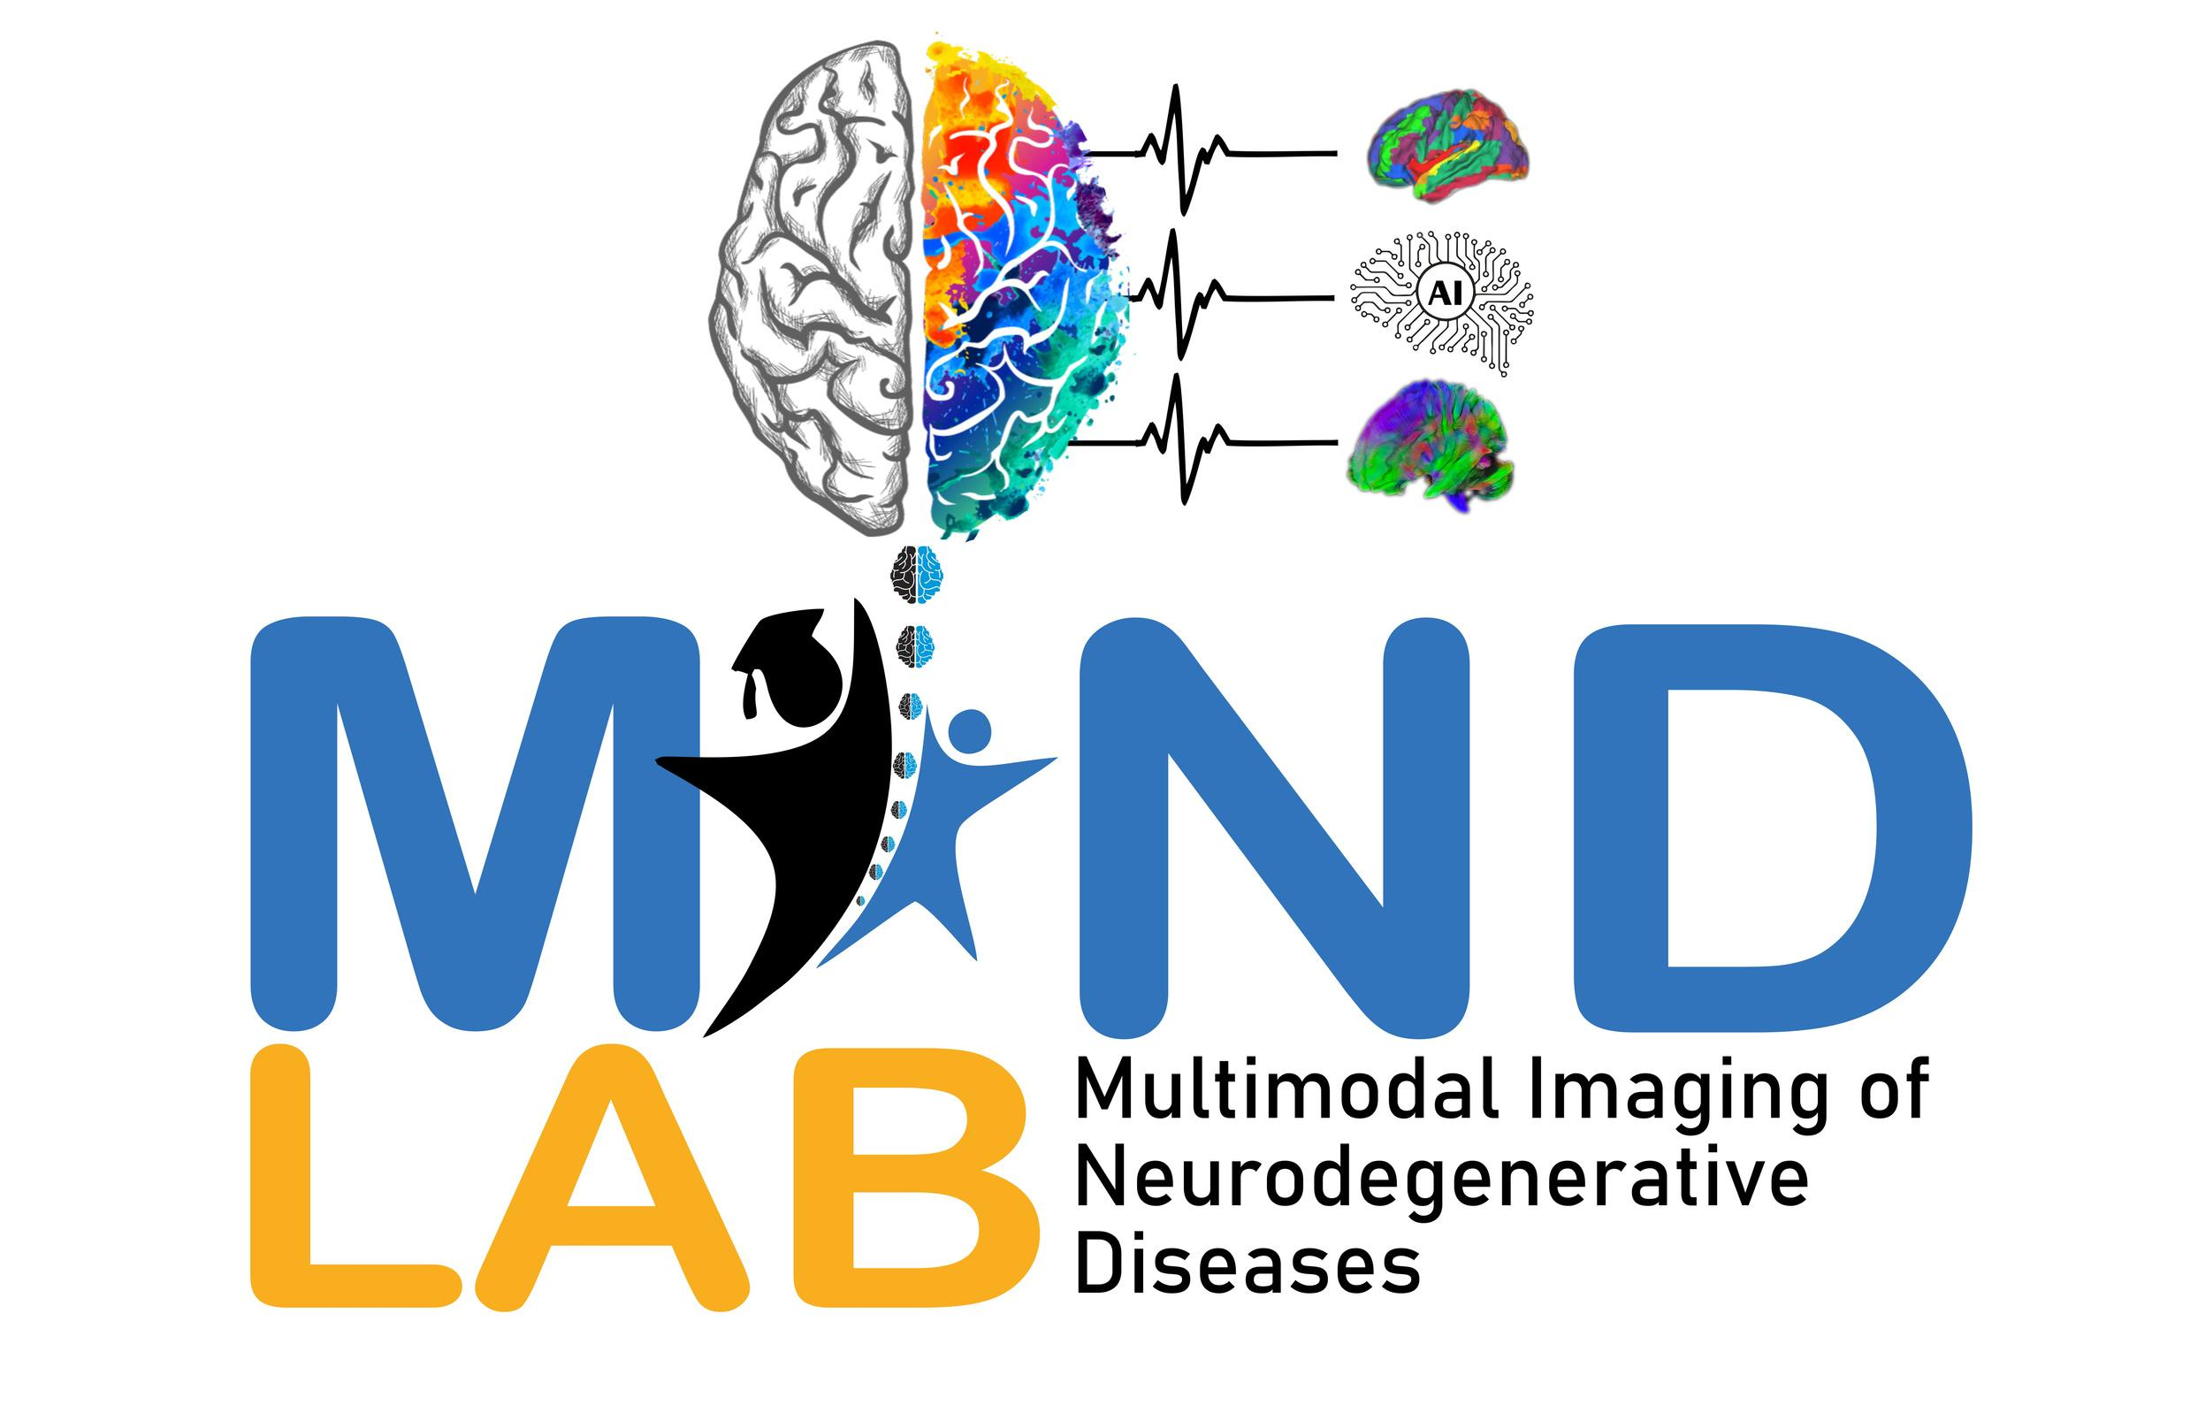


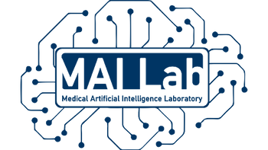
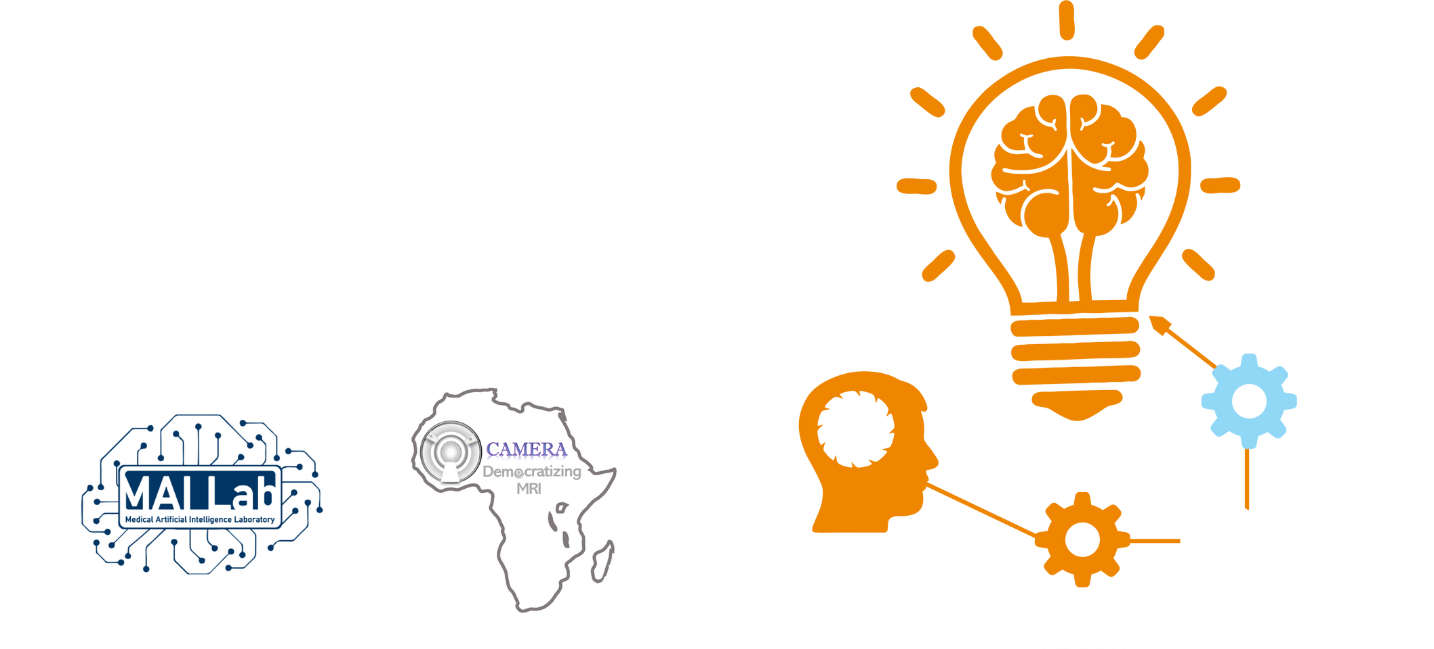
2025 SPARK ACADEMY
TRAIN FOR CHANGE, FROM SCIENCE TO PRACTICE
THE SPRINT AI TRAINING FOR AFRICAN MEDICAL
Imaging Knowledge Translation (SPARK)
Academy
IN DEEP LEARNING & MEDICAL IMAGING
Introduction to Generative AI
April 19th, 2025

Slide 2
Introduction to Generative AI
Class of AI that learn the underlying data distribution and can generate new, realistic data that shares similar characteristics with the original dataset.
Aspect | Traditional AI | Generative AI
Primary Task | Classify, detect, or predict using input data | Generate new data samples resembling training data
Output | Labels, bounding boxes, segmentation masks | Images, videos, 3D structures, or modifications of existing data
Learning Objective | Learn decision boundaries between classes | Learn the joint probability distribution of inputs
Examples | CNNs for classification, U-Net for segmentation | GANs, VAEs, Diffusion Models, Neural Rendering Models
Medical Imaging Use | Tumor classification, organ segmentation | Synthetic data generation, modality translation, segmentation too (believe it or not!)
https://event.fourwaves.com/spark

Slide 3
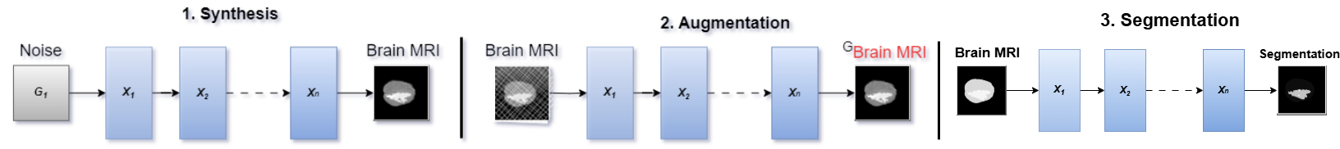
Conditions in Generation
Generative models are either conditioned, or unconditioned.
Type | Description
Unconditional | Generates outputs from pure noise or latent space with no external input
Type | Description
Conditional | Generation is guided by external input (image, label, modality, etc.)
Unconditional Generation Examples
Noise-to-Image: Generate realistic brain MRIs from random noise (DCGAN, StyleGAN)
Latent Sampling: Explore variations in anatomical structures by sampling different latent vectors
Conditional Generation Examples
Image-to-Image: Generate T2 MRI from T1 (Pix2Pix, CycleGAN)
Label-to-Image: Generate anatomy based on segmentation masks
https://event.fourwaves.com/spark

Slide 4
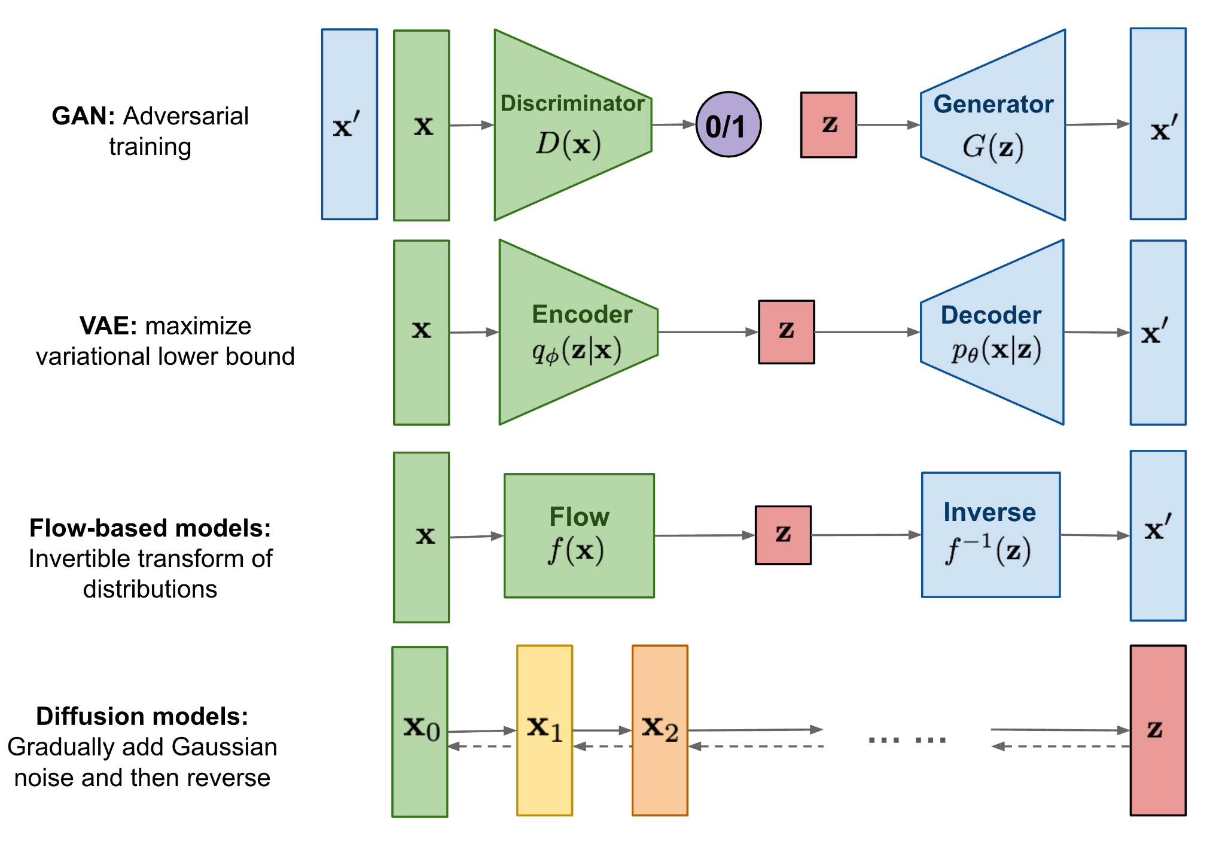
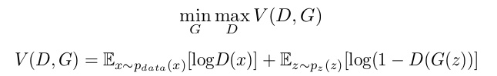
Generative Adversarial Networks
Understanding Loss Functions in GANs: GAN Training and Impact on Results | by Mahzaib Khalid | Medium
Model Type | Key Idea | Common Usage in Medical Imaging
GANs | Two networks compete (Generator vs Discriminator) | Synthetic image generation, style transfer, enhancement
https://event.fourwaves.com/spark

Slide 5
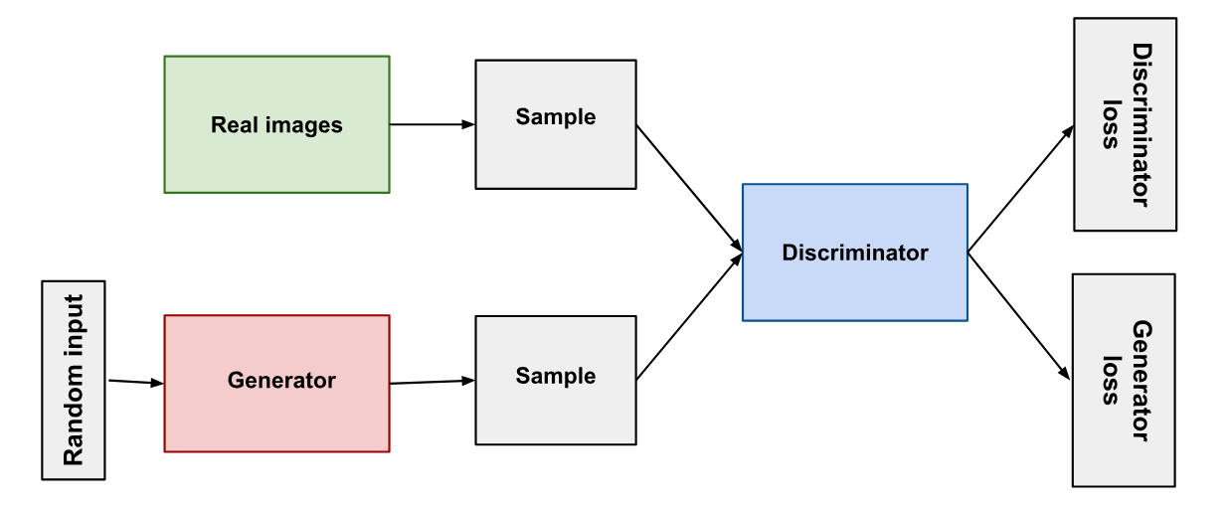
Generative Adversarial Networks
https://event.fourwaves.com/spark

Slide 6
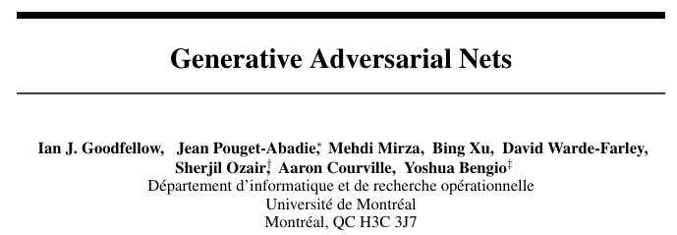
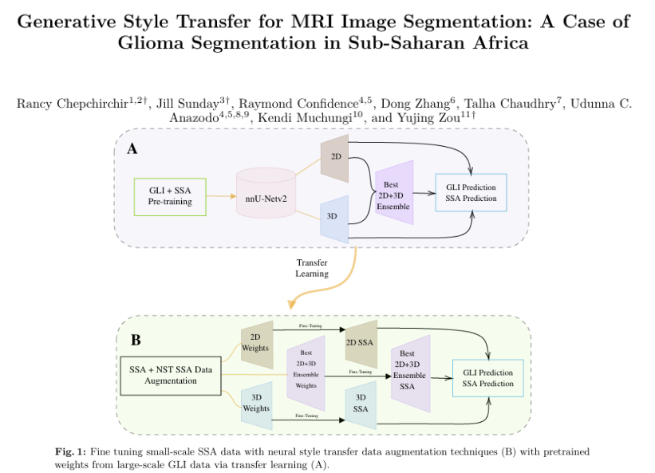
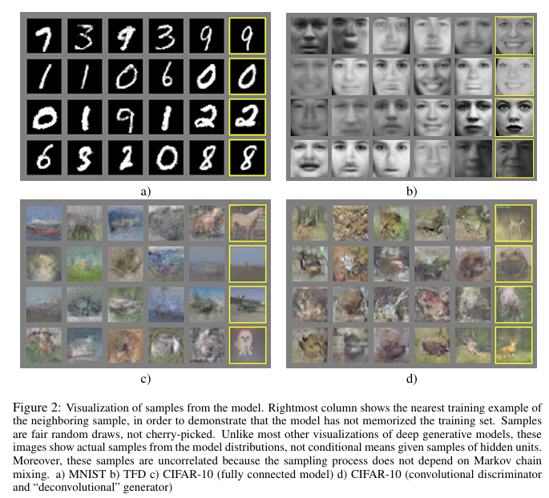
GANs - Literature
https://event.fourwaves.com/spark

Slide 7
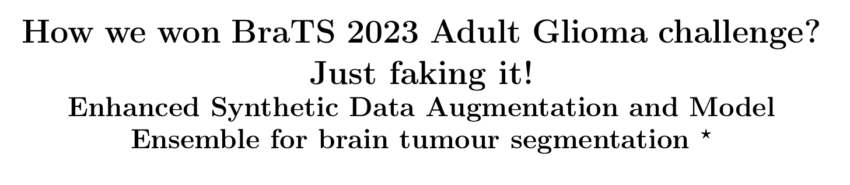
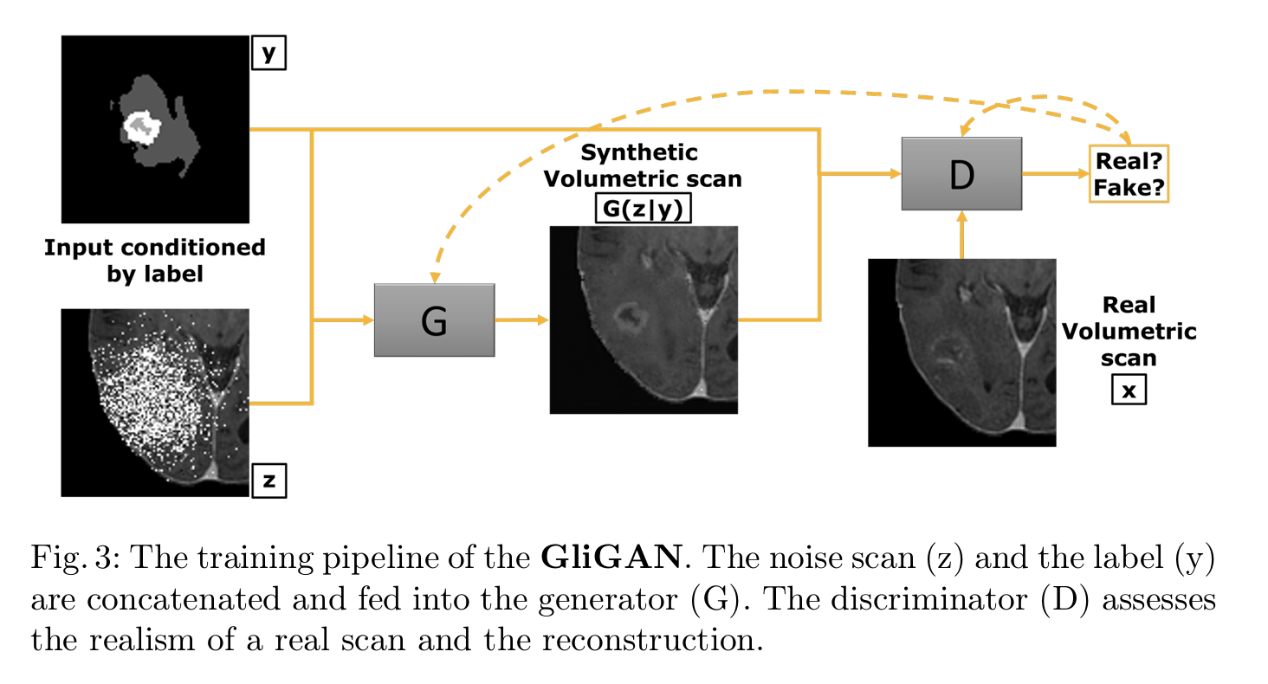
https://arxiv.org/pdf/2402.17317
https://event.fourwaves.com/spark

Slide 8
Variational AutoEncoders
Intuitively Understanding Variational Autoencoders | by Irhum Shafkat | TDS Archive | Medium
Model Type | Key Idea | Common Usage in Medical Imaging
VAEs | Encode → sample → decode | Representation learning
Kullback Leibler - Divergence Loss
https://event.fourwaves.com/spark

Slide 9
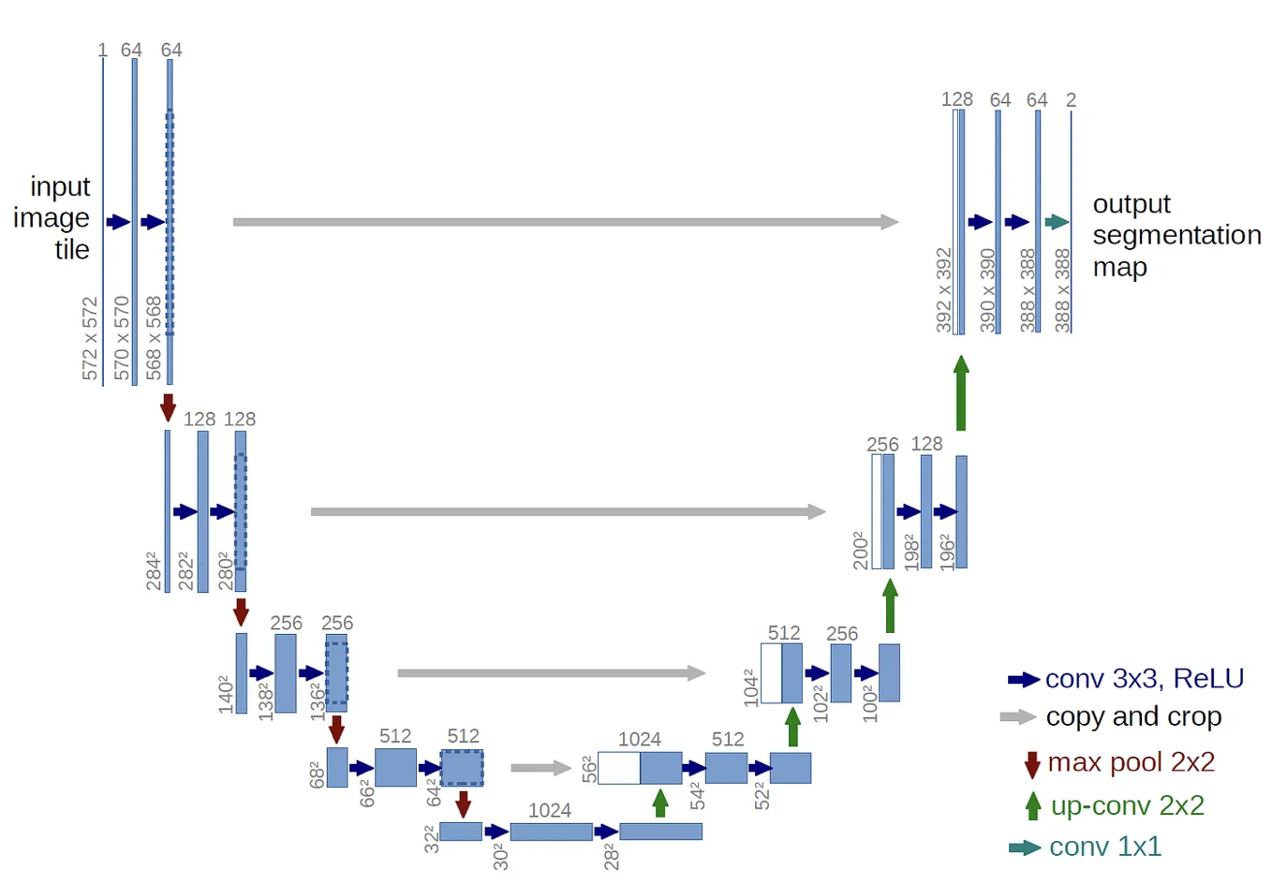
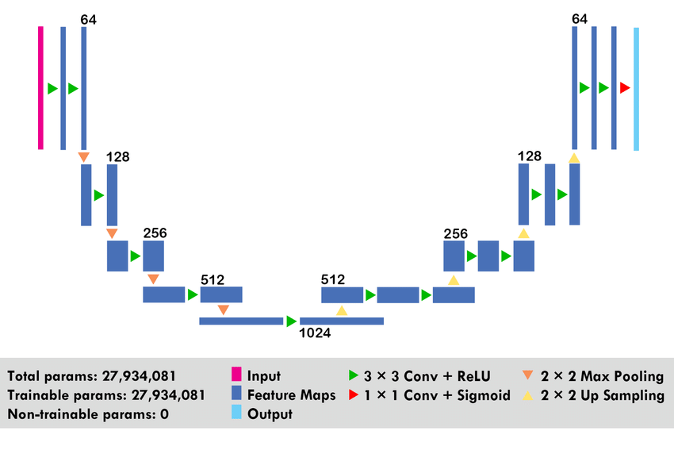
AutoEncoder or U-Net?
Intuitively Understanding Variational Autoencoders | by Irhum Shafkat | TDS Archive | Medium
How is a U-Net different from an AutoEncoder?
Psst.. its the Skip Connections
https://event.fourwaves.com/spark

Slide 10
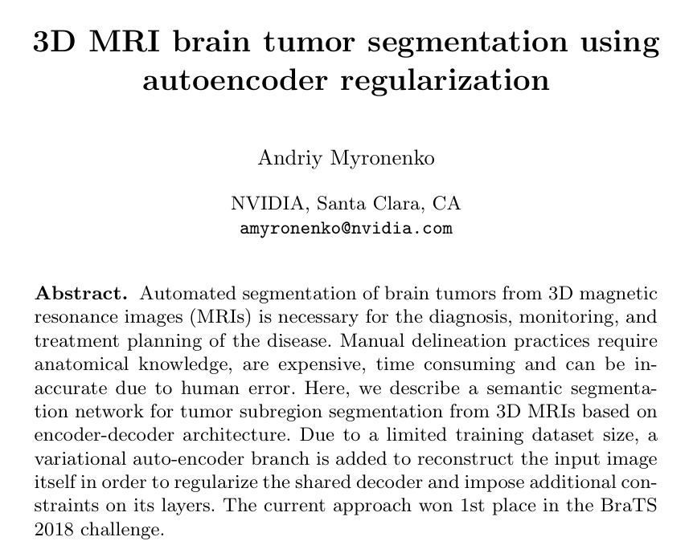
VAE Literature
https://arxiv.org/pdf/1810.11654
https://event.fourwaves.com/spark

Slide 11
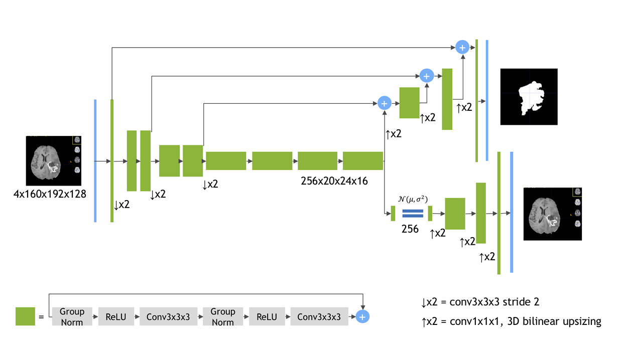
VAE Literature
https://arxiv.org/pdf/1810.11654
https://event.fourwaves.com/spark

Slide 12

Diffusion Models
RPubs - Denoising Diffusion Probabilistic Models
Model Type | Key Idea | Common Usage in Medical Imaging
Diffusion Models | Iteratively denoise random noise | High-quality MRI Synthesis
Diffusion Process
https://event.fourwaves.com/spark

Slide 13
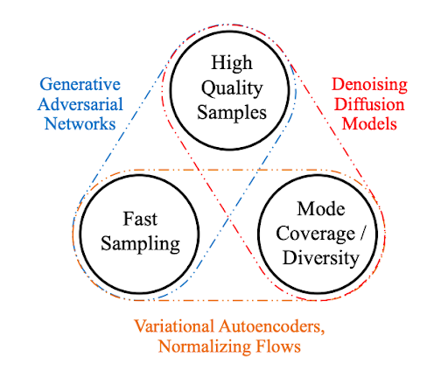
How they compare?
https://event.fourwaves.com/spark

Slide 14
Resources?
Awesome 2D Gen AI - yzy1996/Awesome-Generative-Model: A collection of resources on Generative Model.
https://event.fourwaves.com/spark

